Slide 1
Hybrid consists of two parts, first an unsupervised part that initially labels part of the dataset, then a supervised part that is used on the rest of the dataset
Hierarchical Affinity Propagation clustering is used for the unsupervised learning
Decision Trees are then trained with the clustering labeled data
Metrics used include: FPR, recall, precision, AUCPR and F-score
Three clustering algorithms in addition to HAP to compare the quality of the results. These algorithms were, namely, Partition Around Medoids (PAM), agglomerative Hierarchical Clustering with complete linkage (HC), and IWC (existing solution)
HLMCC outperformed originally labeled data DT models in several evaluation metrics
Scripts in R at https://github.com/nrghanmi/HLMCC_AD_IoT

Slide 2
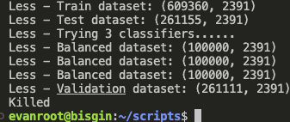
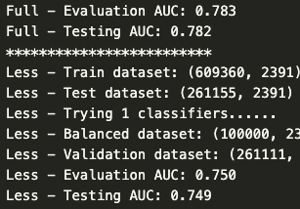
Using Professor Bisgin’s workstation:
Definitely more computational power, but potentially still a little slow (30 min for Main.py)
Since the higher number of classifiers might lead to it being killed (11 as opposed to 1), I may need more computational power
Additionally, the dev-centered results are slightly different than paper’s (0.749 vs. 0.762)
Using 11 classifiers ^
Using 1 classifier (ran!)

Slide 3
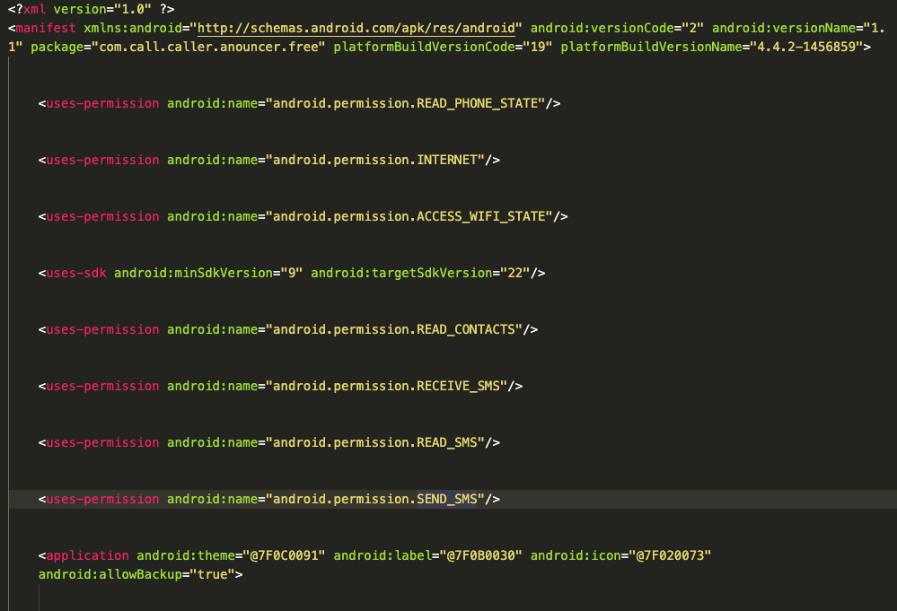
Looking into manifest XMLs:
Working, not able to find any with “SENSORS” or “STORAGE” permissions yet.
However, “SMS” may instead be “RECEIVE_SMS”, “READ_SMS”, and “SEND_SMS”

Slide 4
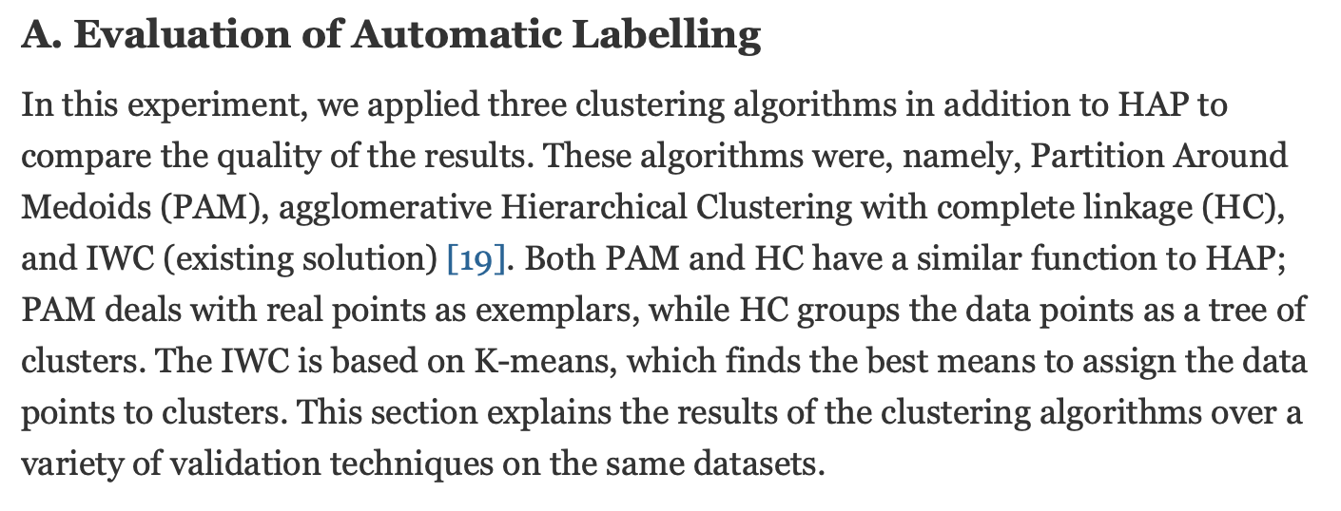
Backup

